Slide 1
Unit 5 PLANNING FOR IS
Total Hour:3hrs
Presented by
Er.Harendra Bikram Shah
Lecturer
Department of BE Computer

Slide 2
OUTLINES
strategic information System
Tactical Information System
Operational Information System

Slide 3

Introduction
Planning is the first primary function of management that precedes all other functions.
The planning function involves the decision of what to do and how it is to be done?
So managers focus a lot of their attention on planning and the planning process.

Slide 4
Introduction
Formal process that develops plan for developing and managing information systems that will support goals of an organization.
Information System plan includes:
Activities planner believes will help achieve goals.
Program for monitoring real-world progress
Means for implementing changes in the plan

Slide 5
Characteristics of Plan
Planning is looking into the future.
Planning involves pre-determined line of action.
Planning discovers the best alternative out of available many alternatives.
Planning requires considerable time for implementation.
Planning is a continuous process.
Planning’s object is to achieve pre-determined objectives in a better way.
Planning integrates various activities of organization.
Planning is done for a specific period.
Planning not only selects the objectives but also develops policies, programmed and procedures to achieve the objectives.
Planning is required at all levels of management.

Slide 6
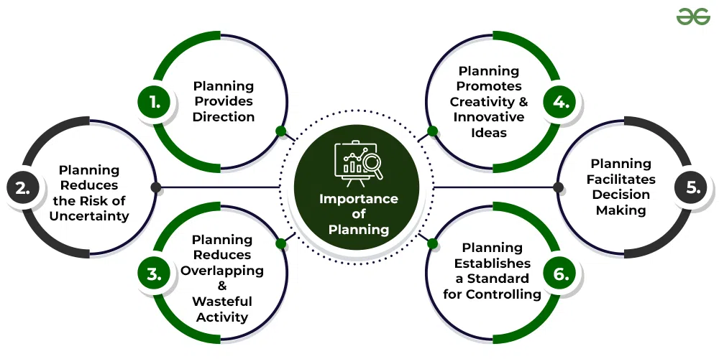
Importance of Plan

Slide 7
Why Plan?
To obtain resources
Financial
Facilities – “Capacity planning”
Staff
To align Information System with the business
To identify needed applications
To establish goal, schedule, and milestone in order to track progress
To provide an opportunity for communication with top management and user management

Slide 8
Approaches to Planning
Top-down Planning
Focuses on organizational goals first, then on the needs of business units
Bottom-up Planning
Focuses on needs of business units first, then on organizational goals

Slide 9
Information System Planning Process
Establish a mission statement
Assess the environment
Set goals and objectives
Derive strategies and policies
Develop long-, medium-, and short-range plans
Implement plans and monitor results

Slide 10
What are Key Elements of IS Planning
Key elements of an IS Plan are
Corporate mission statement
Vision for IT within organization
IS strategic and tactical plans
Operations plan to achieve mission and vision
Budget to ensure resources are available

Slide 11
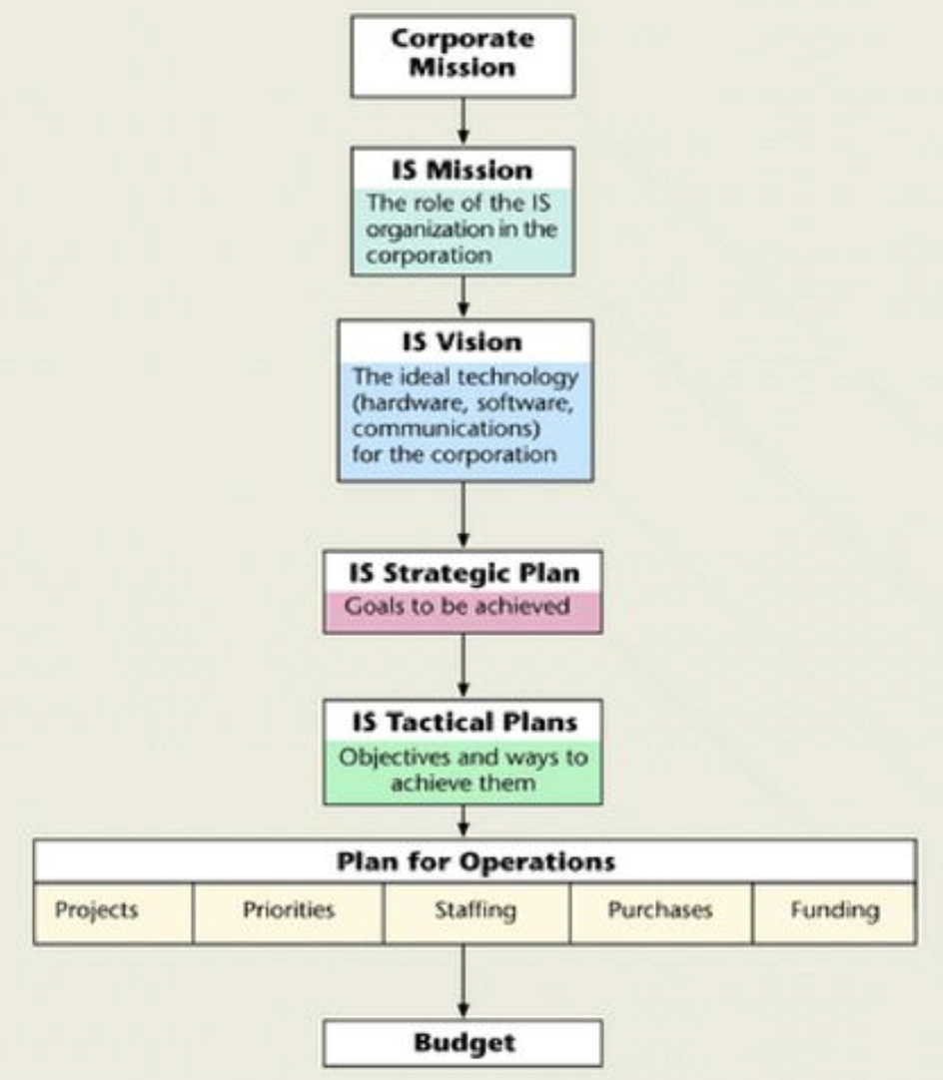
Steps of Information Systems Planning

Slide 12
Strategic Information System
Type of IS that is responsible to implement the business strategy for organizational progress.
It links business and computer strategies.
It shapes an organizational competitive strategy.
It helps an organization to gain a competitive advantage and meet other strategic enterprise objectives.
For example, acquiring a new plant, a new product, diversification of business, etc. comes under strategic information

Slide 13
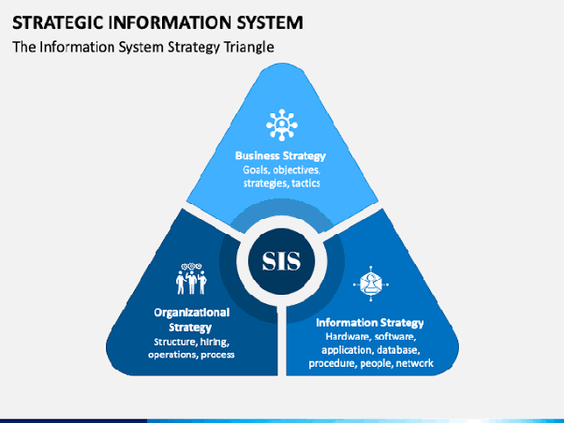
Strategic Information System
SIS Involves:
Formulating a mission for the entire organization.
Identifying the business that helps to meet a mission.
Determination of financial requirements.
Working out authority relationships in terms of organization structure.
Allocating resources effectively.

Slide 14
Typical Strategic-Level Job Titles
Top-level Managers
CEOs or Presidents
General Manager
Corporate Boards
Board of Directors
Steering Committee

Slide 15
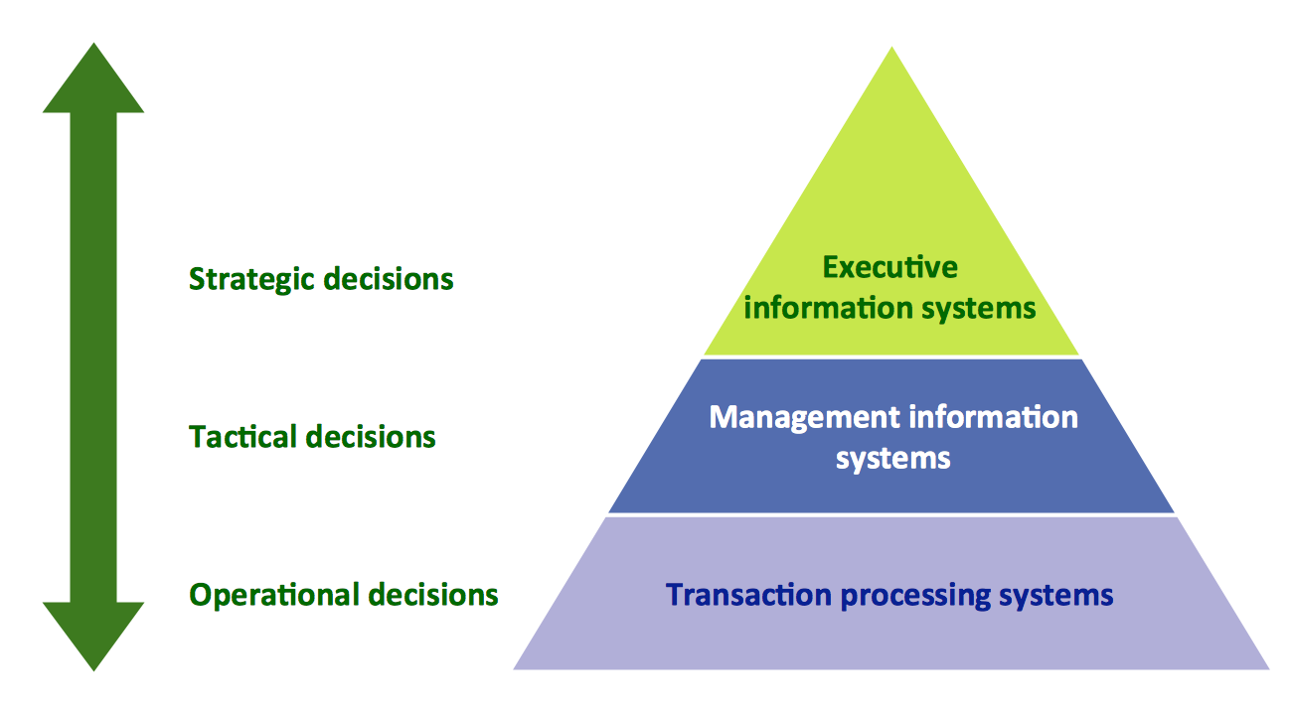
Tactical Information System
Type of information system that is responsible for planning short range tactics emphasizing the current operation of an organization.
Tactical plans are usually developed in the areas of production, marketing, personnel, finance and plant facilities.

Slide 16
Tactical Information System
It involves the decisions in respect of:
Products or services to be added or deleted
Size of capital investments required
Pricing the products and services to be provided
Facilities, methods and systems necessary
Withdrawing investments from, or closing down operations of unprofitable departments or products or services.

Slide 17
Important Factors in IS Tactical
Planning
Flexibility
Compatibility
Connectivity
Scalability
Standardization
Total Cost of Ownership

Slide 18
Typical Tactical-Level Job Titles
Advertising manager
Personnel manager
Creative director
Manager of information systems
Communications director
Chief Financial Officer

Slide 19
Operational Information System
Type of information system that is responsible to aid the daily operations of an organization.
It focuses on how the organization can improve its daily operations.
It processes operational information to plan for operational progress.
carried out by lower-level management comprising unit managers, foremen, line supervisors etc.
It involves decisions in respect of:
Best suitable production methods.
Effective marketing plans.
Organization structure in terms of customer, product or region etc.
Facilities required in the office, factory, sales outlets etc.

Slide 20
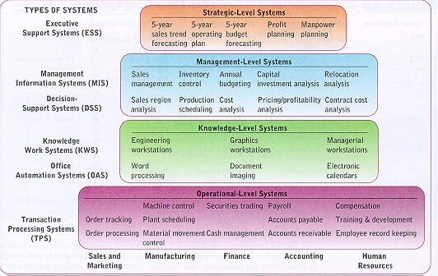
Hierarchy of Planning

Slide 21
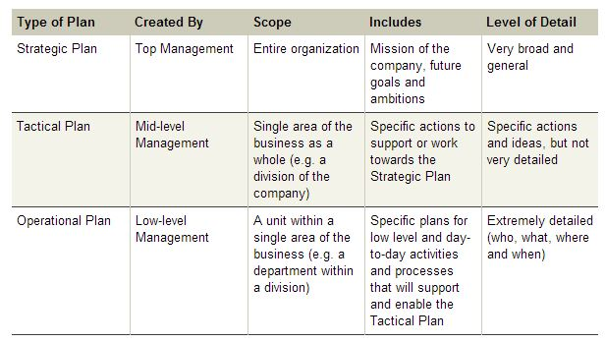
Three level of IS Planning/Planning:

Slide 22
THANK YOU

